Slide 1
Chapter 8
The Enhanced Entity-Relationship (EER) Model

Slide 2
Chapter 8 Outline
Subclasses, Superclasses, and Inheritance
Specialization and Generalization
Constraints and Characteristics of Specialization and Generalization Hierarchies
Modeling of UNION Types Using Categories

Slide 3
Chapter 8 Outline (cont’d.)
A Sample UNIVERSITY EER Schema, Design Choices, and Formal Definitions
Example of Other Notation: Representing Specialization and Generalization in UML
Class Diagrams

Slide 4
The Enhanced Entity-Relationship (EER) Model
Enhanced ER (EER) model
  Created to design more accurate database schemas
    Reflect the data properties and constraints more precisely
  More complex requirements than traditional applications

Slide 5
Subclasses, Superclasses, and Inheritance
EER model includes all modeling concepts of the ER model
In addition, EER includes:
  Subclasses and superclasses
  Specialization and generalization
  Category or union type
  Attribute and relationship inheritance

Slide 6
Subclasses, Superclasses, and Inheritance (cont’d.)
Enhanced ER or EER diagrams
  Diagrammatic technique for displaying these concepts in an EER schema
Subtype or subclass of an entity type
  Subgroupings of entities that are meaningful
  Represented explicitly because of their significance to the database application

Slide 7
Subclasses, Superclasses, and Inheritance (cont’d.)
Terms for relationship between a superclass and any one of its subclasses
  Superclass/subclass
  Supertype/subtype
  Class/subclass relationship
Type inheritance
  Subclass entity inherits all attributes and relationships of superclass

Slide 8
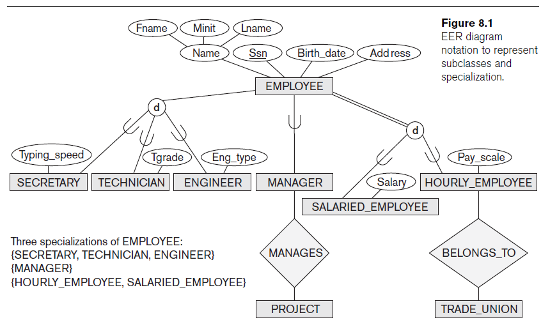
Notes:
A class/subclass relationship is often called an IS-A (or IS-AN) relationship because of the way we refer to the concept. We say a SECRETARY is an EMPLOYEE, a TECHNICIAN is an EMPLOYEE, and so on.

Slide 9
Specialization and Generalization
Specialization
  Process of defining a set of subclasses of an entity type
  Defined on the basis of some distinguishing characteristic of the entities in the superclass
Subclass can define:
  Specific attributes
  Specific relationship types
Notes:
Subclass of Part-time (has hourly_rate) or Full-time (yearly_rate) EMPLOYEE

Slide 10
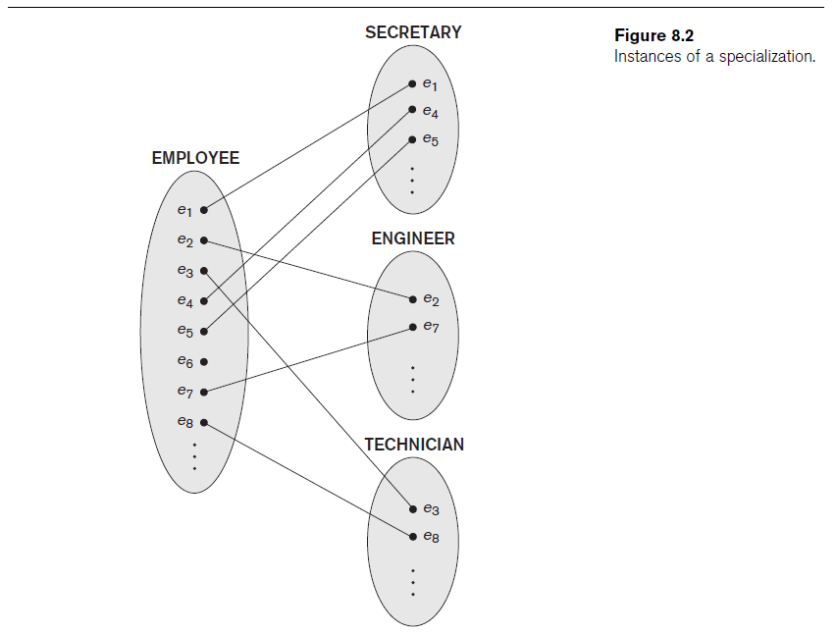

Slide 11
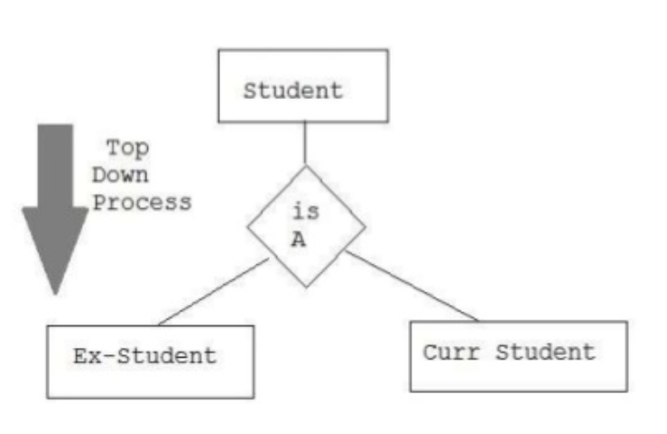
Specialization and Generalization (cont’d.)
Specialization
  is a top-down approach
  one higher level entity can be broken down into lower level entities. In specialization, some higher level entities may not have lower-level entity sets at all.

Slide 12
Specialization and Generalization (cont’d.)
Certain attributes may apply to some but not all entities of the superclass
Some relationship types may be participated in only by members of the subclass

Slide 13
Generalization
Reverse process of abstraction
Generalize into a single superclass
  Original entity types are special subclasses
Generalization
  Process of defining a generalized entity type from the given entity types
Notes:
The process of extracting common characteristics from two or more classes and combining them into a generalized superclass, is called Generalization. The common characteristics can be attributes or modules.

Slide 14
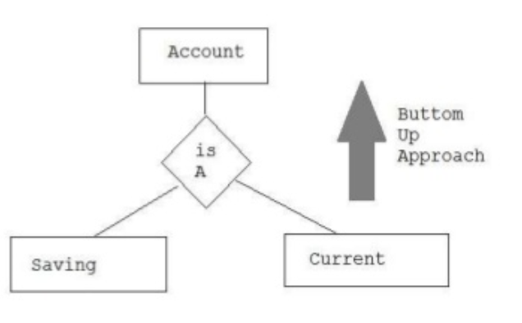
Generalization (cont’d.)
Generalization
  is a bottom-up approach
  two (or more) lower level entities combine to form a higher level entity
  In generalization, the higher level entity can also combine with other lower level entity to make further higher level entity

Slide 15
Constraints and Characteristics of Specialization and Generalization Hierarchies
Constraints that apply to a single specialization or a single generalization
Differences between specialization/ generalization lattices and hierarchies

Slide 16
Constraints on Specialization and Generalization
May be several or one subclass
Determine entity subtype:
  Predicate-defined (or condition-defined) subclasses
  Attribute-defined specialization
  User-defined

Slide 17
Constraints on Specialization and Generalization (cont’d.)
Disjointness constraint
  Specifies that the subclasses of the specialization must be disjoint
Completeness (or totalness) constraint
  May be total or partial
Disjointness and completeness constraints are independent
Notes:
Hence, we have the following four possible constraints on specialization:
Disjoint, total
Disjoint, partial
Overlapping, total
Overlapping, partial

Slide 18
Specialization and Generalization Hierarchies and Lattices
Specialization hierarchy
  Every subclass participates as a subclass in only one class/subclass relationship
  Results in a tree structure or strict hierarchy
Specialization lattice
  Subclass can be a subclass in more than one class/subclass relationship

Slide 19
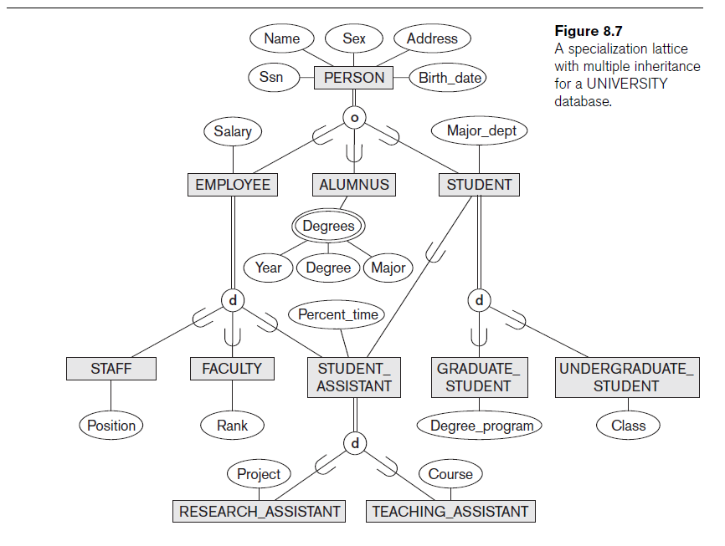
Notes:
Completeness : Total or Partial
Double lines (=) to the circle shows total specialization (Every tuple in superclass must be at least a member of subclass).
Single line to the circle (-) shows partial specialization (Allows an entity to not to belong to any of the subclasses).

Slide 20
Specialization and Generalization Hierarchies and Lattices (cont’d.)
Multiple inheritance
  Subclass with more than one superclass
  If attribute (or relationship) originating in the same superclass inherited more than once via different paths in lattice
    Included only once in shared subclass
Single inheritance
  Some models and languages limited to single inheritance

Slide 21
Utilizing Specialization and Generalization in Refining Conceptual Schemas
Specialization process
  Start with entity type then define subclasses by successive specialization
  Top-down conceptual refinement process
Bottom-up conceptual synthesis
  Involves generalization rather than specialization

Slide 22
Modeling of UNION Types Using Categories
  Union type or a category
  Represents a single superclass/subclass relationship with more than one superclass
  Subclass represents a collection of objects that is a subset of the UNION of distinct entity types
  Attribute inheritance works more selectively
  Category can be total or partial
Some modeling methodologies do not have union types

Slide 23
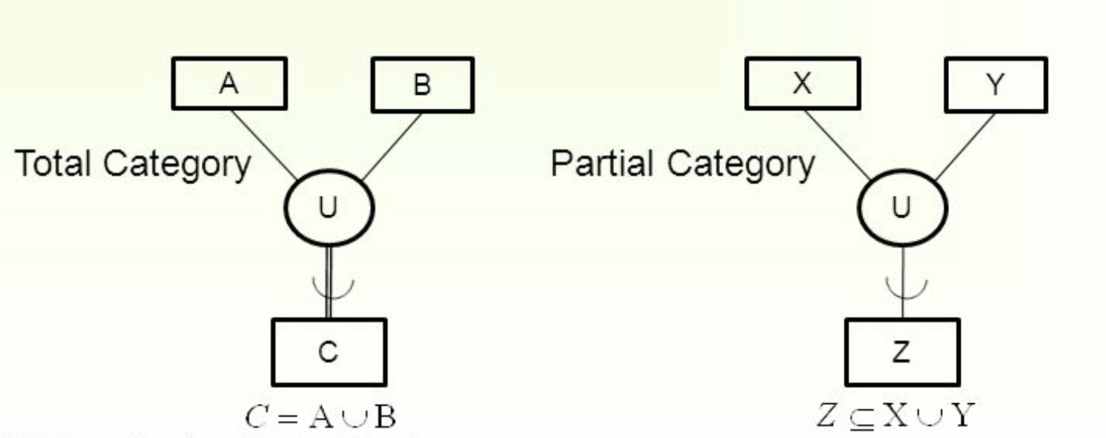
Modeling of UNION Types Using Categories

Slide 24
A Sample UNIVERSITY EER Schema, Design Choices, and Formal Definitions
The UNIVERSITY Database Example
  UNIVERSITY database
    Students and their majors
    Transcripts, and registration
    University’s course offerings

Slide 25
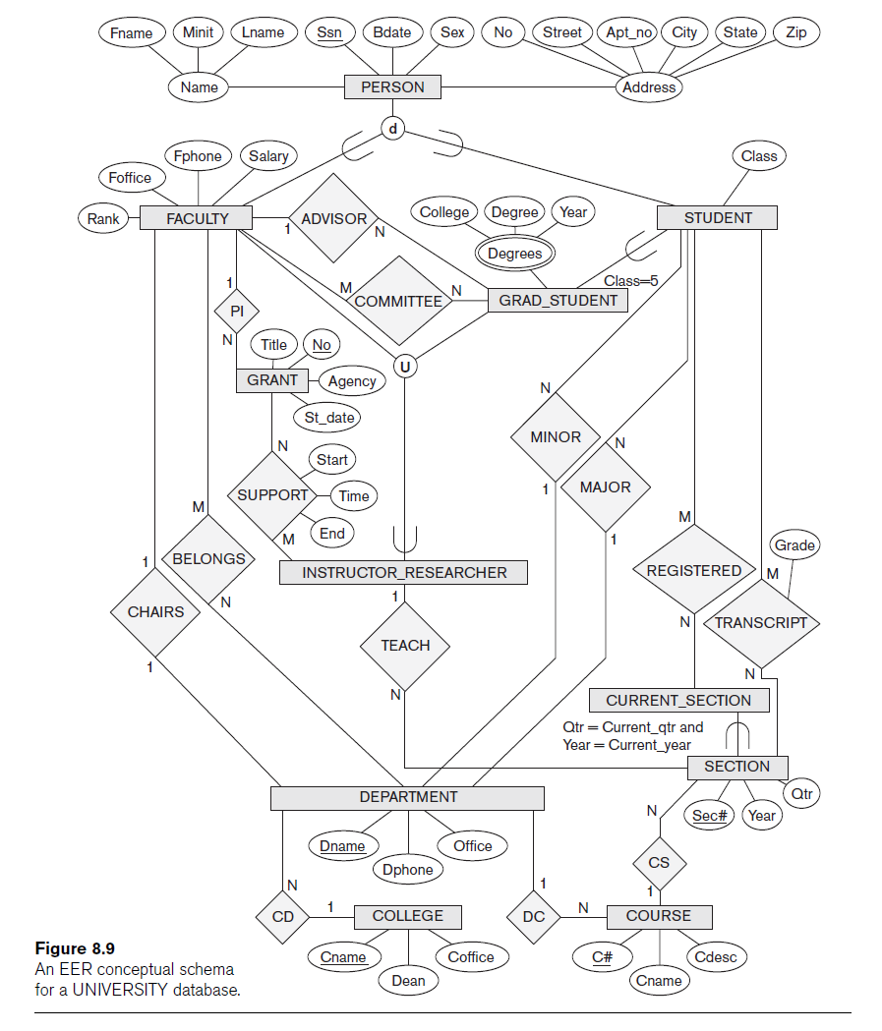
Notes:
An Improved EER conceptual schema for a UNIVERSITY database
U = Union Type or a category = Represents a single Superclass/Subclass relationship with more than one superclass.
d = Disjointness
o = Overlapping

Slide 26
Design Choices for Specialization/Generalization
Many specializations and subclasses can be defined to make the conceptual model accurate
If subclass has few specific attributes and no specific relationships
  Can be merged into the superclass

Slide 27
Design Choices for Specialization/Generalization (cont’d.)
If all the subclasses of a specialization/generalization have few specific attributes and no specific relationships
  Can be merged into the superclass
  Replace with one or more type attributes that specify the subclass or subclasses that each entity belongs to

Slide 28
Design Choices for Specialization/Generalization (cont’d.)
Union types and categories should generally be avoided
Choice of disjoint/overlapping and total/partial constraints on specialization/generalization
  Driven by rules in miniworld being modeled

Slide 29
Formal Definitions for the EER Model Concepts
Class
  Set or collection of entities
  Includes any of the EER schema constructs of group entities
Subclass
  Class whose entities must always be a subset of the entities in another class
Specialization
  Set of subclasses that have same superclass

Slide 30
Formal Definitions for the EER Model Concepts (cont’d.)
Generalization
  Generalized entity type or superclass
Predicate-defined
  A subclass S of C is said to be predicate-defined if a predicate p on the attributes of C is used to specify which entities in C are members of S (e.g. income >0)
User-defined
  Subclass that is not defined by a predicate

Slide 31
Formal Definitions for the EER Model Concepts (cont’d.)
Category
  Class that is a subset of the union of n defining superclasses
Relationship type
  Any class can participate in a relationship

Slide 32
Example of Other Notation
Representing specialization and generalization in UML class diagrams
  Basic notation
    See Figure 8.10
  Base class
    Root superclass
  Leaf classes
    Subclasses (leaf nodes)
Notes:
UML class diagram

Slide 33
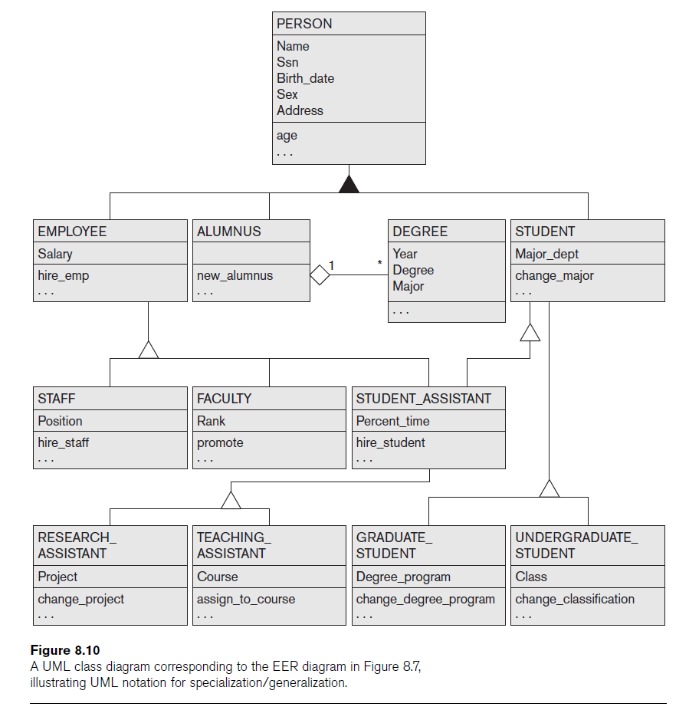
Notes:
UML notation for specialization/ generalization
IS-A Relationship

Slide 34
Classification and Instantiation
Classification
  Systematically assigning similar objects/entities to object classes/entity types
Instantiation
  Inverse of classification
  Generation and specific examination of distinct objects of a class
Notes:
Classification : Collections of objects that share the same types of attributes, relationships, and constraints are classified into classes in order to simplify the process of discovering their properties.
Instantiation : An object instance is related to its object class by the IS-AN- INSTANCE-OF or IS-A-MEMBER-OF relationship.
Although EER diagrams do not display instances, the UML diagrams allow a form of instantiation by permitting the display of individual objects

Slide 35
Specialization and Generalization
Specialization
  Classify a class of objects into more specialized subclasses
Generalization
  Generalize several classes into a higher-level abstract class
  Includes the objects in all these classes

Slide 36
Aggregation and Association
Association
  Associate objects from several independent classes (Association between objects)
Aggregation
  Allows us to treat a “relationship set” as an “entity set” for purpose of participation in other relationships
Composition
  Composition implies ownership. When an association instance is deleted, participating objects may not continue to exist e.g. JOB_OFFER
Notes:
Aggregation describes “Has a” relationship.
If we delete the COMPANY or JOB_APPLICANT, JOB_OFFER may not continue to exist.

Slide 37
Difference between Aggregation and Composition
Main structural distinction of Aggregation and composition
  In aggregation, when an association instance is deleted
    Participating objects may continue to exist
  In composition, when an association instance is deleted
    Participating objects may NOT continue to exist
Notes:
The abstraction of association is used to associate objects from several independent classes. is called IS-ASSOCIATED-WITH

Slide 38
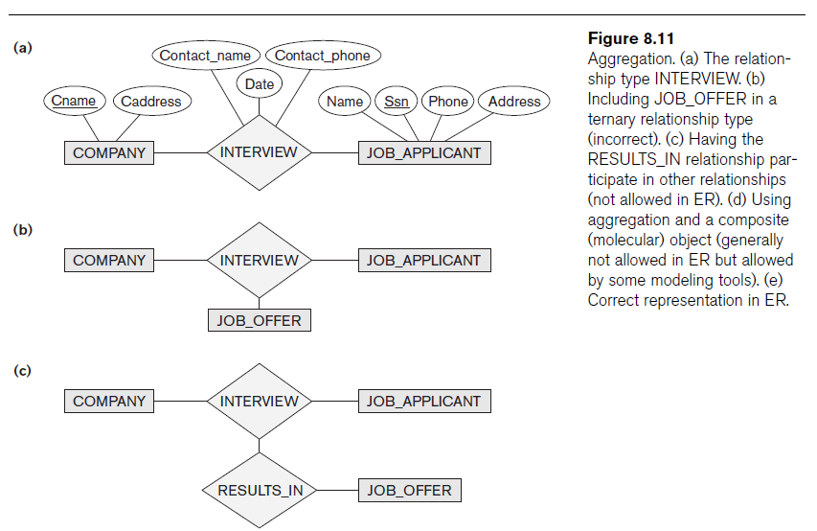
Notes:
The relationship type INTERVIEW
Including JOB_OFFER in a ternary relationship type (incorrect)
Having the RESULTS_IN relationship participate in other relationship (not allowed in EER)
Using aggregation and a composite object (not allowed in EER)
Correct Representation in ER

Slide 39
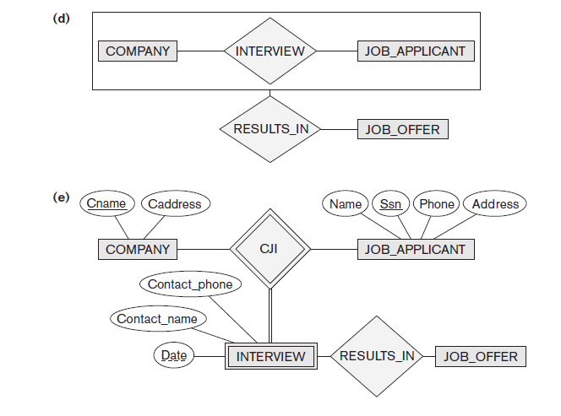
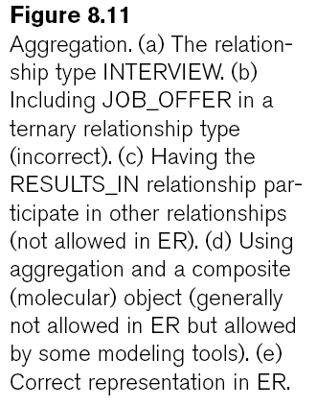
Notes:
d) Using aggregation and a composite object (not allowed in EER)
e) Correct Representation in ER

Slide 40
Summary
Enhanced ER (or EER model)
  Extensions to ER model that improve its representational capabilities
  Subclass and its superclass
  Category (or union type)
Notation and terminology of UML for representing specialization and generalization

